Slide 1

Automated Agent-Driven Trading Platform
Transforming financial markets with AI and machine learning.
Revolutionizing trading efficiency, accuracy, and scalability.

Slide 2
Problem Statement
The Challenge:
- Fragmented and inefficient trading tools.
- Limited adaptability to user-defined business rules.
- Growing complexity of financial data and market dynamics.
- Need for predictive, automated, and scalable trading solutions.

Slide 3
The Solution
Our Platform:
- AI/ML-driven trading solution that adapts to user-defined business rules.
- Advanced forecasting capabilities using NLP, time-series analysis, and macroeconomic modeling.
- Modular, scalable architecture supporting both automated and manual trading.
- Built with continuous improvement and agile methodologies.

Slide 4
Market Opportunity
The Financial Technology Market:
- Global fintech market size: $150 billion (2024) with a 20% CAGR.
- Automated trading platforms account for $10 billion with a 25% CAGR.
- Target users: Hedge funds, VCs, financial analysts, and independent traders.

Slide 5
Key Features
- AI-Powered Analytics: Machine learning models for predictive analysis.
- Real-Time Data Integration: APIs, NLP for sentiment analysis, technical indicators.
- User-Defined Rules: Customizable inputs for enhanced decision-making.
- Automation & Alerts: Automated execution or manual approval workflows.

Slide 6
Competitive Advantage
What Sets Us Apart:
- Combines advanced AI models with customizable business logic.
- Real-time scenario planning and predictive analysis.
- Fully scalable platform adaptable for multiple asset classes.
- Unique mix of financial expertise and technological innovation.

Slide 7

Business Model
Revenue Streams:
1. Subscription Plans: Tiered pricing based on user needs (basic to enterprise).
2. Licensing: White-label solutions for institutional clients.
3. Consulting Services: Custom development and integration support.
4. Performance Fees: Based on the value generated for users.

Slide 8
Technology Stack
- Data Layer: Real-time ingestion, historical data storage, API integrations.
- AI/ML Layer: Time-series models (LSTM, ARIMA), NLP for sentiment analysis.
- Execution Layer: Automated trading bot, manual override options.
- User Interface: Intuitive dashboards for scenario building and trade execution.

Slide 9
Traction
- 8 Months of R&D: Research with financial market experts and traders.
- Prototypes Built: Trading bot leveraging custom business rules.
- User Feedback: Strong interest from potential institutional clients.

Slide 10
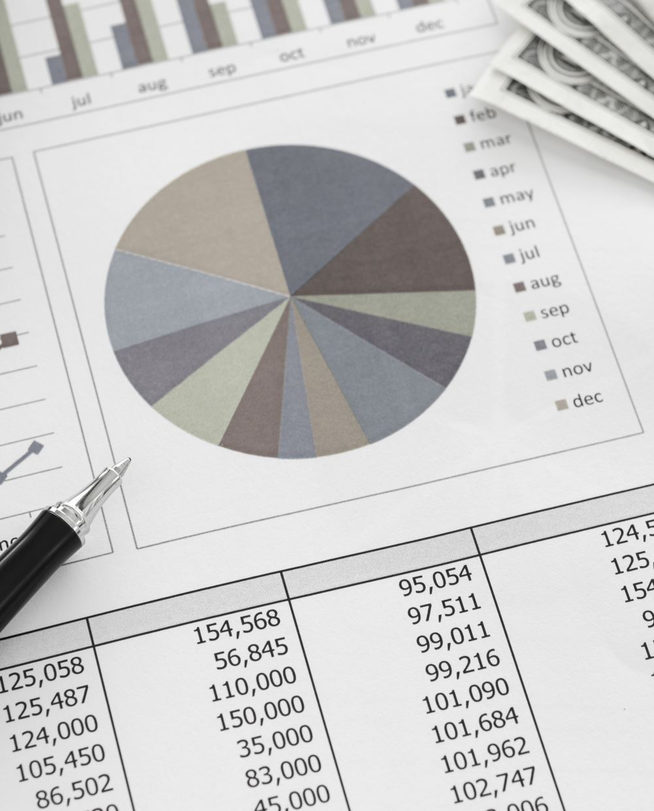
Financial Projections
- Year 1: $2M in revenue from early adopters and institutional pilots.
- Year 2: $8M with a 300% user growth.
- Year 3: $20M by scaling enterprise adoption and adding asset classes.

Slide 11

Investment Ask
Raising: $3M Seed Funding
- 40%: Product development and AI model refinement.
- 30%: Sales and marketing to penetrate key markets.
- 20%: Scaling data infrastructure.
- 10%: Operational and regulatory compliance.
Investor Opportunity: Projected ROI of 5x within 3 years.

Slide 12
Roadmap
Phase 1: MVP (6 months)
- Build core data ingestion and forecasting engine.
- Launch pilot with beta users.
Phase 2: Expansion (12 months)
- Enhance UI/UX and add NLP capabilities.
- Secure partnerships with brokers and data providers.
Phase 3: Full Rollout (18 months)
- Automated trading execution.
- Scale to multi-asset trading.

Slide 13
Team
- Founder: Christopher Taylor- 20+ years in tech and financial services.
- AI/ML Lead: - Expert in time-series and NLP models.
- Product Manager: - Background in fintech product development.
- Advisors: Seasoned financial and technical professionals.

Slide 14
Vision & Strategic Partnership
Our Vision:
To redefine the trading landscape with AI-powered tools.
Partner with a visionary investor or fintech firm to bring this platform to market efficiently.
Strategic Partnership Options:
Pre-negotiated valuation for the company with exclusive rights.
Capital raise with the investor as the anchor partner.
Post-delivery options:
Full acquisition.
Majority ownership with autonomy.
Divestment or alternative M&A pathways.
The Opportunity:
Leverage our platform for rapid market entry.
Avoid build-from-scratch risks with a proven, scalable model.
Secure a first-mover advantage in automated trading.

Slide 15
Call to Action
Let’s Shape the Future of Trading
- Join us in revolutionizing financial markets.

Slide 16

Thank You

Slide 17
Appendix

Slide 18

Vision & Strategic Partnership
Our Vision:
Redefine the trading landscape with AI-powered tools.
Collaborate with visionary investors, fintech firms, or institutional players.
Strategic Partnership Options:
Pre-negotiated valuation and exclusivity rights.
Capital raise with anchor investor involvement.
Post-delivery options: Full acquisition, major/minor stake adjustment, or divestment.
The Opportunity:
Avoid build-from-scratch risks with a proven, scalable model.
Secure first-mover advantage in automated trading.

Slide 19
High-Level Architecture
Core Components:
- Data Layer: Real-time data ingestion, processing, and governance.
- Modeling Layer: Time-series forecasting, NLP-driven sentiment analysis.
- Orchestration Layer: Automated execution, risk management.
- User Interface: Intuitive dashboards, scenario builders, and trading consoles.
Development Phases:
1. MVP: Core data ingestion and basic forecasting.
2. Expansion: Advanced modeling and user customization.
3. Full Rollout: End-to-end automation and multi-asset support.

Slide 20
Competitive Landscape
Key Differentiators:
Customizable user-defined business rules.
Integration of advanced AI/ML models for predictive analytics.
Scalable, modular architecture adaptable across asset classes.
Robust backtesting, real-time execution, and risk management tools.
Market Comparison:
Outpaces traditional platforms lacking real-time adaptability and AI-driven insights.

Slide 21
Next Steps & Timeline
Phase 1: MVP Development (6 Months)
- Core data ingestion and initial forecasting models.
- Pilot testing with a simulated trading environment.
Phase 2: Expansion (12 Months)
- Add macroeconomic modeling, NLP sentiment analysis, and user dashboards.
- Strategic partnerships and early adoption campaigns.
Phase 3: Full Rollout (18 Months)
- Fully automated trading capabilities.
- Support for multi-asset portfolios and institutional clients.

Slide 22
Competitive Landscape
How We Stand Out:
Unique integration of AI/ML, sentiment analysis, and user-defined business rules.
Real-time adaptability and robust predictive analytics.
Scalable, cloud-based solution across multiple asset classes.
Competitor Analysis:
Traditional Platforms: Limited real-time adaptability, lack of AI-driven forecasting.
Emerging Platforms: Focused narrowly on specific analytics or markets.

Slide 23
Traction and Early Adopters
Demonstrating Interest:
Early discussions with institutional investors and fintech firms.
Positive feedback on prototypes and concept from industry experts.
Next Steps:
Launch beta program with selected retail and institutional traders.
Build partnerships with key fintech players.

Slide 24
Investor Highlights
Why Invest Now:
Proven market demand for automated trading solutions.
Scalable cloud infrastructure for global adoption.
Strong team with expertise in tech and finance.
Exit Opportunities:
Fintech partnerships leading to acquisitions.
Licensing deals with institutional clients.

Slide 25
Use of Funds
Allocation of $3M Seed Round:
Development & AI Model Refinement: 40%.
Sales & Marketing: 30%.
Infrastructure Scaling: 20%.
Regulatory Compliance: 10%.
Focused on rapid product readiness and market penetration.

Slide 26
Market Strategy
Path to Market:
Engage institutional partners for pilot programs.
Direct outreach to fintech firms for strategic alignment.
Build retail user base through partnerships and targeted marketing.
Scaling Approach:
Expand to multi-asset trading.
Leverage feedback for continuous improvement and iteration.

